Slide 1

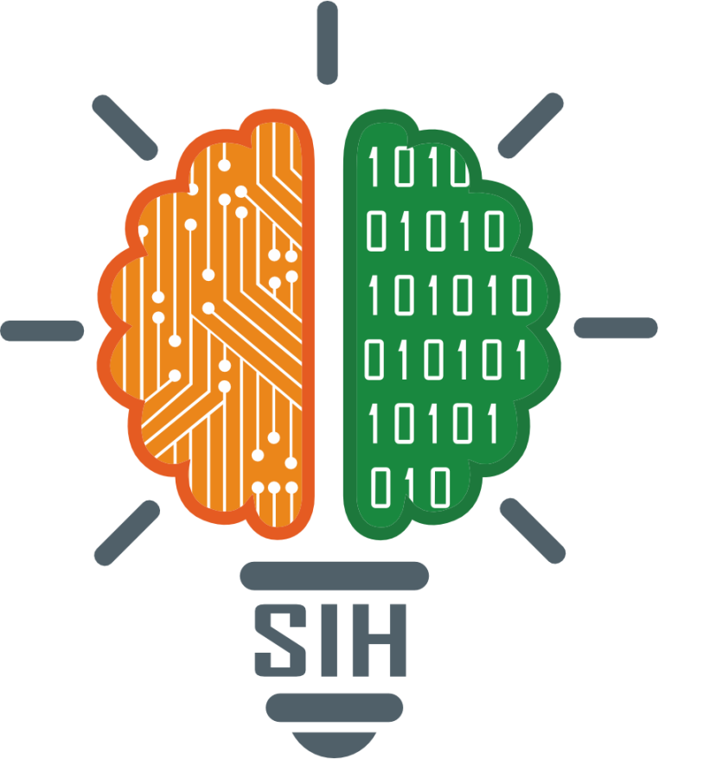
SMART INDIA HACKATHON 2024
TITLE PAGE
Problem Statement ID – SIH1598
Problem Statement Title- Student Innovation
Theme- Heritage & Culture
PS Category- Software
Team ID-
Team Name (Registered on portal)

Slide 2

IDEA TITLE
Nivaran
Proposed Solution
Idea :
Solution :
Prototype :
Proposed Solution: Our website promotes India's rich cultural heritage, focusing on lesser-known towns, villages, and traditions. The platform has two core sections:
Heritage Value: Highlights historically significant places, traditions, and foods with detailed information.
Word of Mouth: A sustainable model where small businesses can list services, with sponsorship options for better visibility.
Key Features:
State and City Pages: Explore the history, culture, and heritage of each region.
User Engagement: Interactive reviews, ratings, and recommendations.
Affiliate Programs: Partnerships with platforms like Airbnb and local guides.
Community Section: Future plans to engage foreign users and promote Indian culture globally.
Preservation of Culture: The website preserves India's heritage by documenting traditional knowledge, making it accessible globally.
Support for Local Economies: It promotes local businesses and sustainable tourism by giving lesser-known establishments visibility.
Enhanced Travel Planning: The platform simplifies travel planning, helping users discover hidden attractions and local customs.
Government Benefits: It aids heritage conservation, boosts tourism revenue, and supports local governance with centralized cultural resources.
Education: The website serves as an educational resource, offering historical and cultural information that promotes awareness and understanding of India’s diverse heritage.
Social Impact: The platform fosters a sense of pride and identity among locals, motivating them to protect and promote their heritage.
Accessibility: It offers a user-friendly interface information regardless of their tech expertise.
Curated Cultural Content: Focuses on lesser-known Indian culture, offering in-depth insights and historical context to enhance travel experiences.
Modern Design: Combines traditional Indian art with modern UX for better user engagement and cultural representation.
Interactive Features: Includes user-generated reviews and recommendations, fostering a community of cultural enthusiasts.
Future Expansion: Plans to introduce a community section for foreign users to promote Indian culture and showcase local artistry, encouraging cross-cultural exchange.
Personalized Recommendations: The platform can offer personalized suggestions based on user preferences, making the cultural exploration more relevant and tailored.
Cultural Blog and Articles: Includes regularly updated blog posts and articles that highlight cultural trends, local stories, and historical perspectives, keeping the content fresh and engaging.

Slide 3





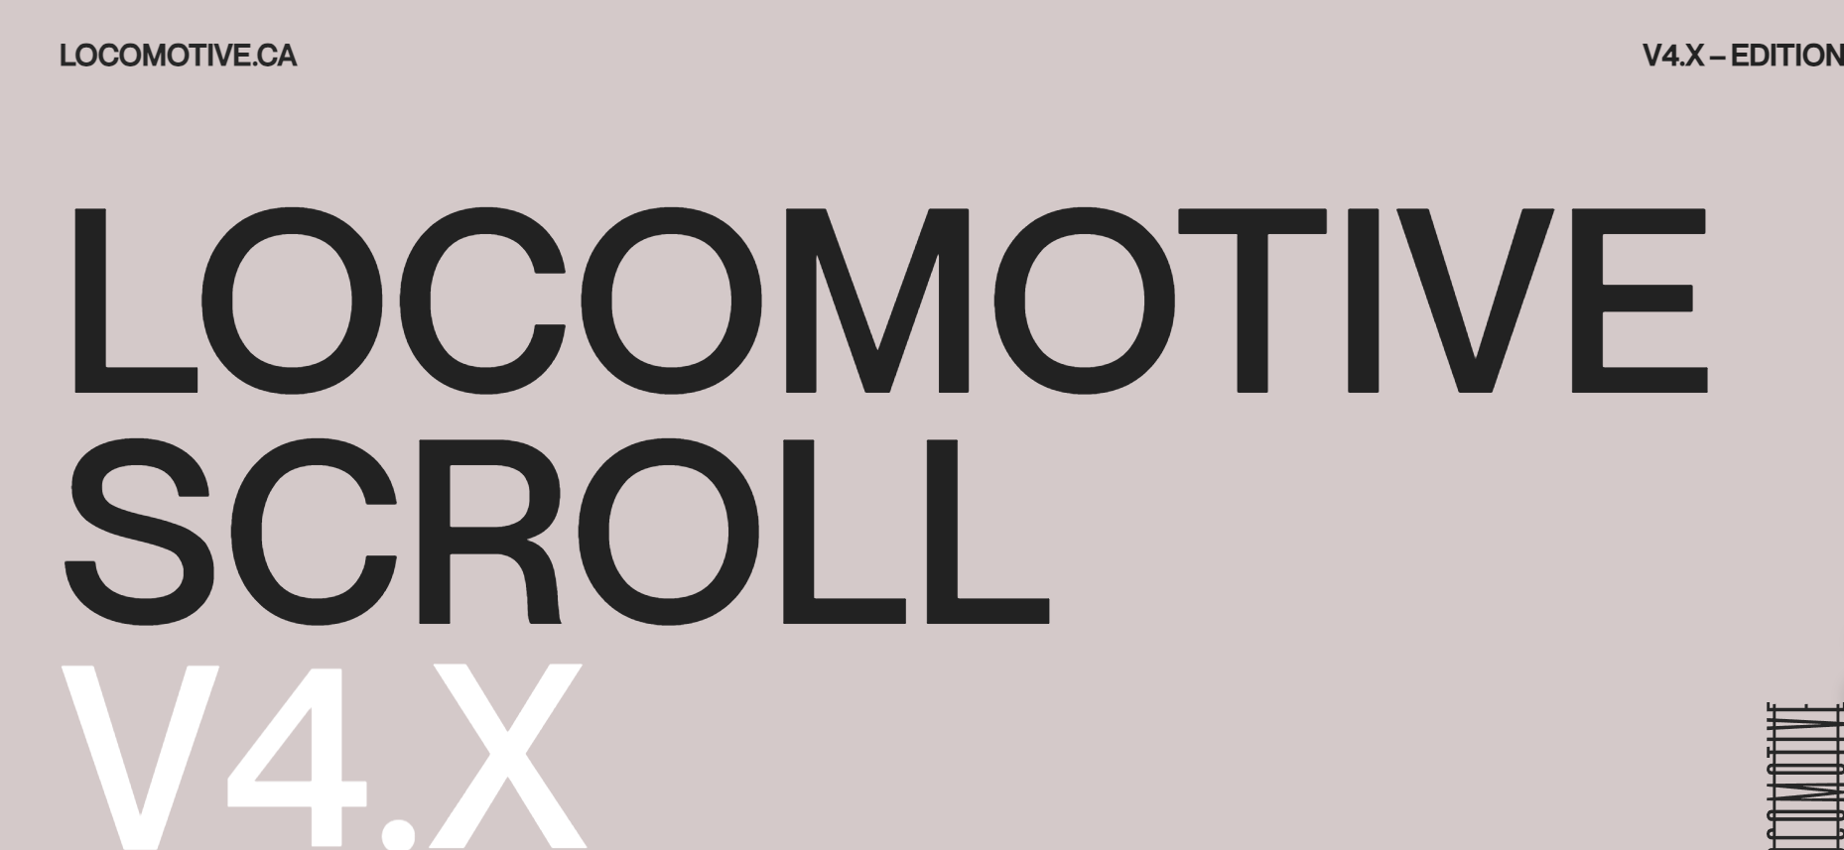


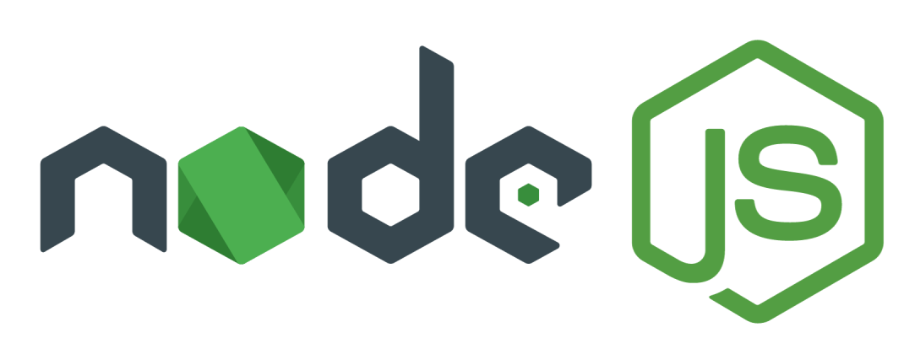


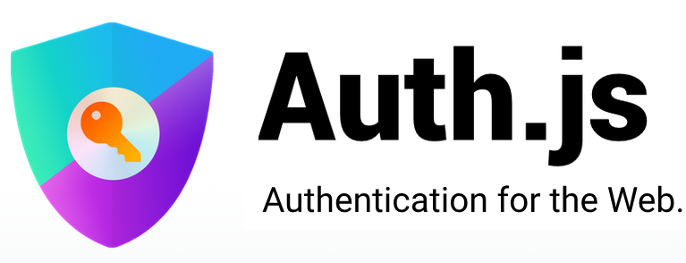


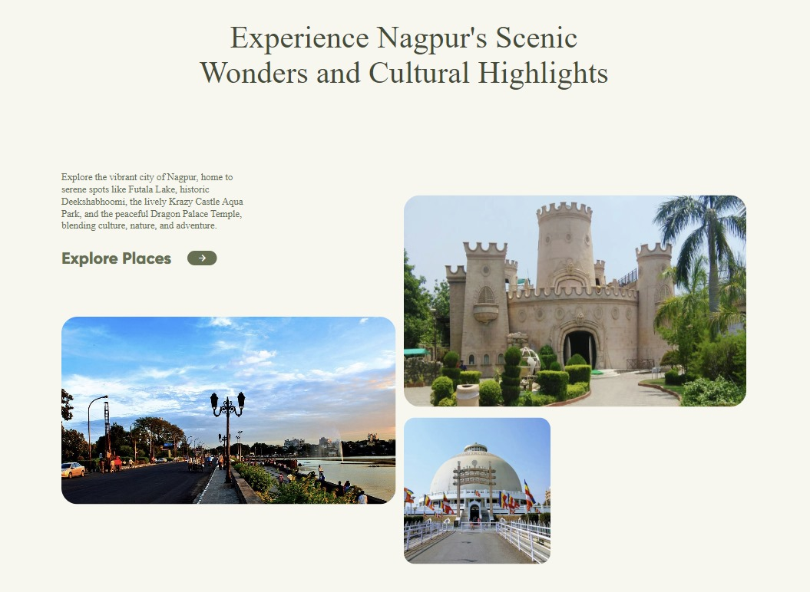
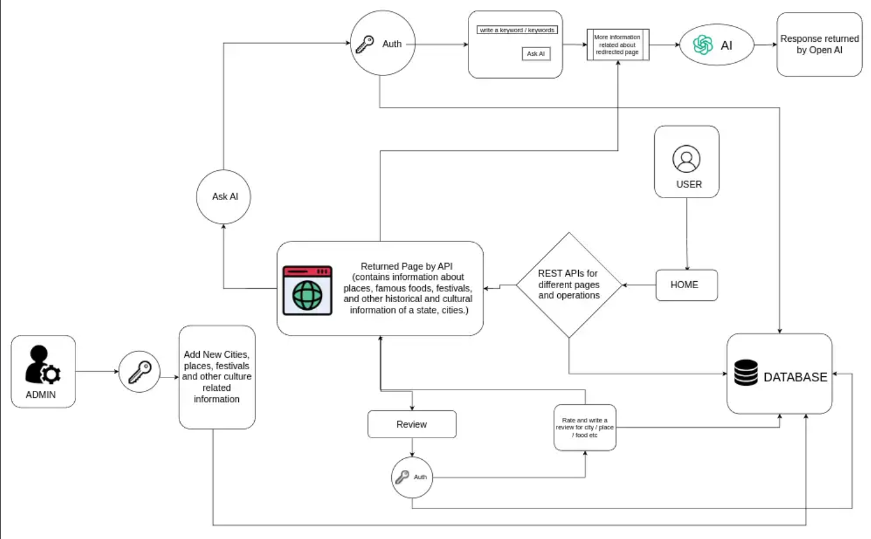
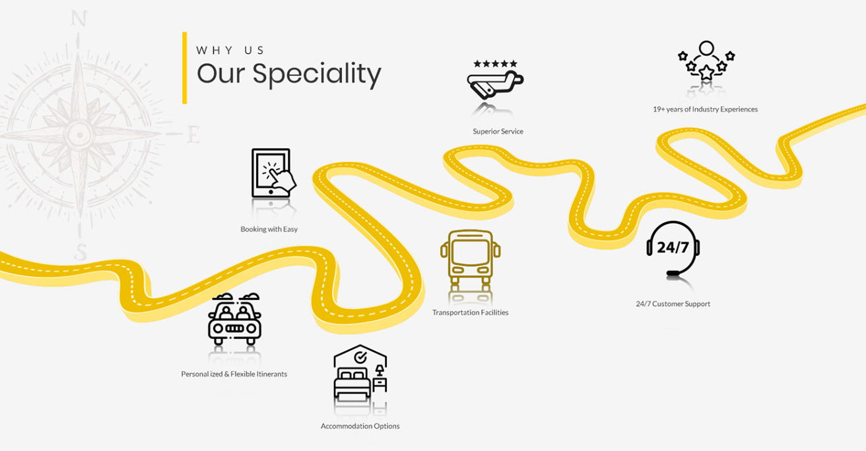
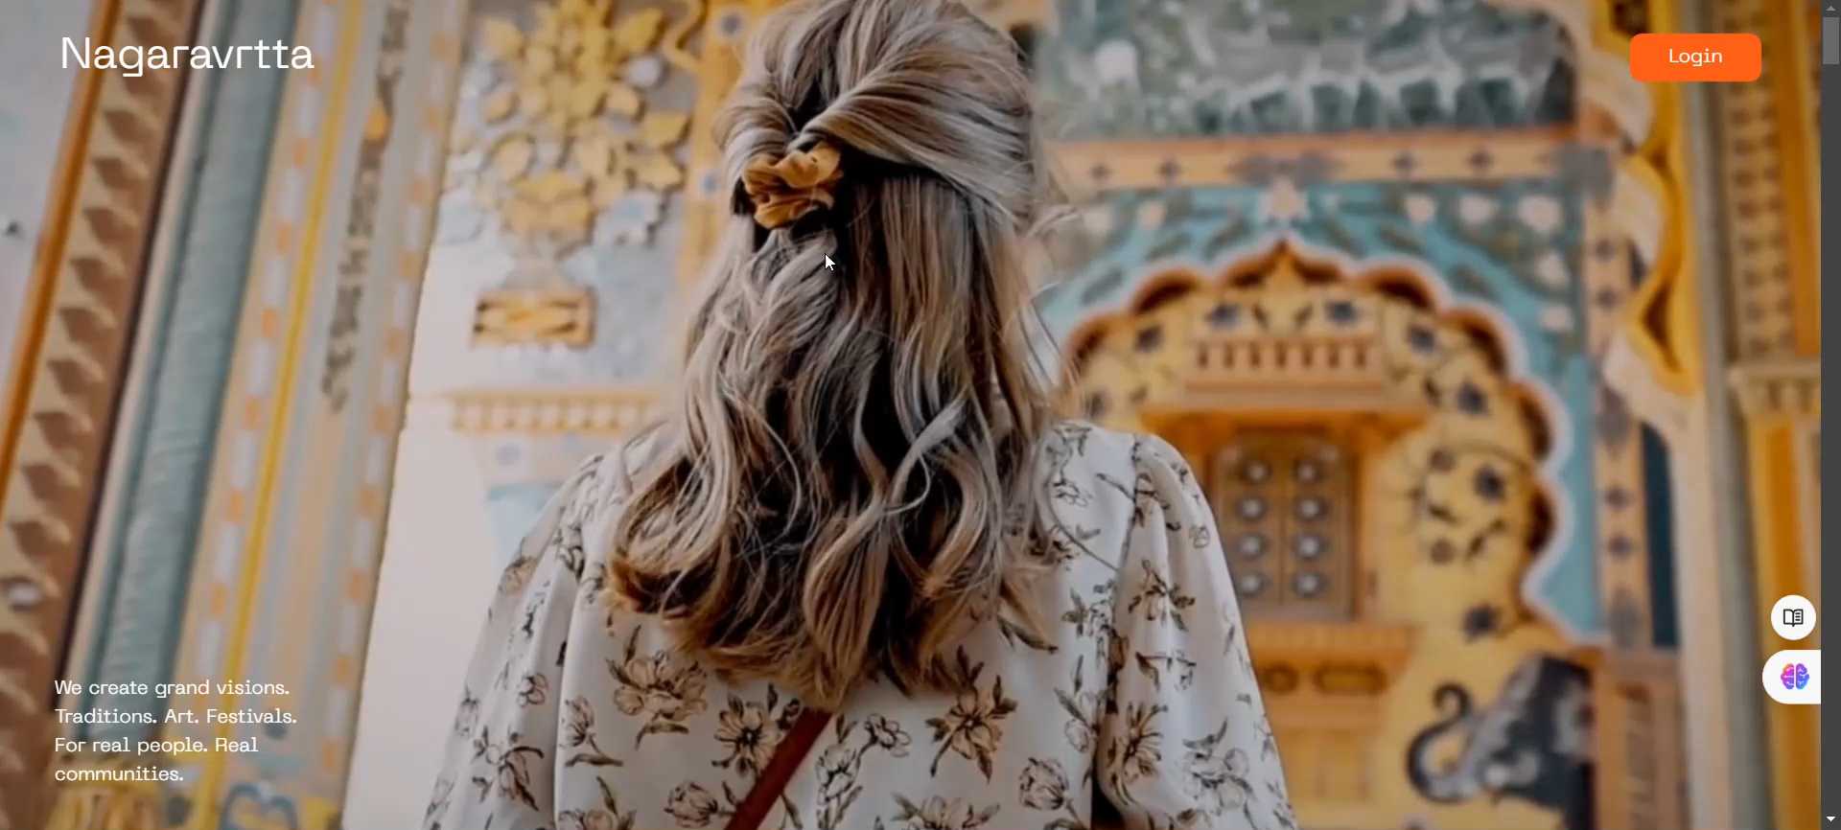
TECHNICAL APPROACH
Technologies used :
Nivaran
Insights :-
Flowchart :-

Slide 4
FEASIBILITY AND VIABILITY
Nivaran
Analysis of Feasibility :
Potential Challenges and Risks :
Strategies for Overcoming Challenges :
1. Technical Feasibility:
Development Skills: Expertise in front-end and back-end development is essential for creating a user-friendly interface and structured layout.
Infrastructure: Reliable hosting and scalability, supported by cloud-based solutions and content delivery networks, are necessary for performance.
2. Financial Feasibility:
Initial Investment: Funding for development, design, and marketing can be secured through sponsors, grants, or investments.
Revenue Streams: The platform will earn through listings, sponsorships, and affiliate tie-ups, with partnerships key for sustainability.
3. Market Feasibility:
Target Audience: Interest in cultural tourism and heritage preservation indicates strong market potential, with research enhancing relevance.
Competition: Focusing on lesser-known Indian culture provides a unique niche against broader travel websites.
1. Technical Strategies:
Performance Optimization: Implement caching, compress images, and use a content delivery network to enhance performance.
Security Measures: Employ SSL certificates, secure coding practices, and regular security audits to safeguard user data.
2. Financial Strategies:
Funding Sources: Explore diverse funding options, including grants, sponsorships, crowdfunding, and partnerships with cultural organizations.
Revenue Models: Test different monetization strategies and gather feedback to find the right balance between user experience and revenue generation.
3. Market Strategies:
Engagement Tactics: Use targeted marketing campaigns, social media, and partnerships to attract users. Regularly update content to keep the audience engaged.
Cultural Expertise: Collaborate with local experts and cultural ambassadors to ensure accurate and respectful representation. Conduct user feedback sessions to address concerns and improve content.
1. Technical Challenges:
Website Performance: Ensuring fast load times and smooth navigation, especially with rich media content, may be challenging.
Data Security: Protecting user data and preventing breaches requires robust security measures.
2. Financial Risks:
Funding: Securing sufficient initial funding and sustaining revenue through sponsorships and listings can be difficult.
Monetization: Balancing user experience with monetization strategies to avoid appearing overly commercialized.
3. Market Risks:
User Engagement: Attracting and retaining users might be challenging if the content does not resonate or if the website lacks sufficient promotion.
Cultural Sensitivity: Accurate and respectful representation of diverse cultures is crucial. Missteps could lead to backlash.

Slide 5
IMPACT AND BENEFITS
Nivaran
Potential Impact on the Target Audience :
Benefits of the Solution :
Support for Heritage Conservation: Promoting lesser-known sites can boost awareness and lead to better protection and maintenance.
Community Engagement: Encourages user participation through sharing experiences and reviews, fostering a network of cultural ambassadors.
Economic Benefits for Rural Areas: Distributes tourism benefits to smaller towns, creating jobs and promoting economic development.
Cultural Exchange: Facilitates understanding between cultures by connecting travelers with local traditions.
Sustainable Tourism: Supports less-explored destinations and local businesses, promoting responsible travel.
Personalized Recommendations: Uses algorithms to offer tailored suggestions based on user interests.
Interactive Content: Engages users with features like virtual tours and quizzes for a richer experience.
Cultural Institution Collaboration: Partners with museums and heritage organizations to enhance content credibility and access expert knowledge
1. Social Benefits:
Cultural Preservation: Showcasing lesser-known traditions helps preserve endangered cultural practices.
Community Engagement: Fosters local pride and encourages heritage protection.
Education and Awareness: Serves as an educational tool, promoting cultural diversity and awareness.
2. Economic Benefits:
Boost to Local Economy: Small businesses and local accommodations benefit from increased tourism.
Job Creation: Supports jobs in tourism, guiding, and hospitality, especially in lesser-known areas.
Revenue from Sponsorships: Premium listings and affiliate tie-ups ensure financial sustainability.
3. Environmental Benefits:
Sustainable Tourism: Promoting lesser-known areas reduces overcrowding and balances tourism.
Conservation Support: Encourages responsible tourism and supports conservation of cultural heritage.

Slide 6
RESEARCH AND REFERENCES
Nivaran
Reference and research work :
Design & Structure :
Data & Information :
Video Used in website: https://youtu.be/m8qf5bSmlQQ?si=eJV8MZkhxWsFOtdD
Image Source :
https://unsplash.com/
https://www.midjourney.com/home
Design Inspiration :
https://www.behance.net/gallery/204876611/Travel-Tourism-UI-UX-Design?tracking_source=search_projects|tourism+ui+design&l=43
https://in.pinterest.com/
Data Used in website:
https://chatgpt.com/
https://www.wikipedia.org/
https://www.youtube.com/

